Slide 1

Capstone Project-3
Mobile Price Range Prediction
Submitted By:
Jyoti Singh

Slide 2

Content :
1. Defining problem statement
2. EDA and feature engineering
3. Feature Selection
4. Preparing dataset for modelling
5. Applying Model
6. Model Validation and Selection
7. Conclusion

Slide 3
Problem Statement
In the competitive mobile phone market the companies want to understand sales data of mobile phones and factors which drive the prices. The objective is to find out some relation between features of a mobile phone (e.g. Ram, Internal memory etc.) and Its selling price. In this problem, we do not have to predict the actual price but a price range indicating how high the price.
This will basically help companies to estimate the price of mobiles to give tough competition to other mobile manufacturers.
Also, it will be useful for consumers to verify that they are paying the best price for a mobile.

Slide 4
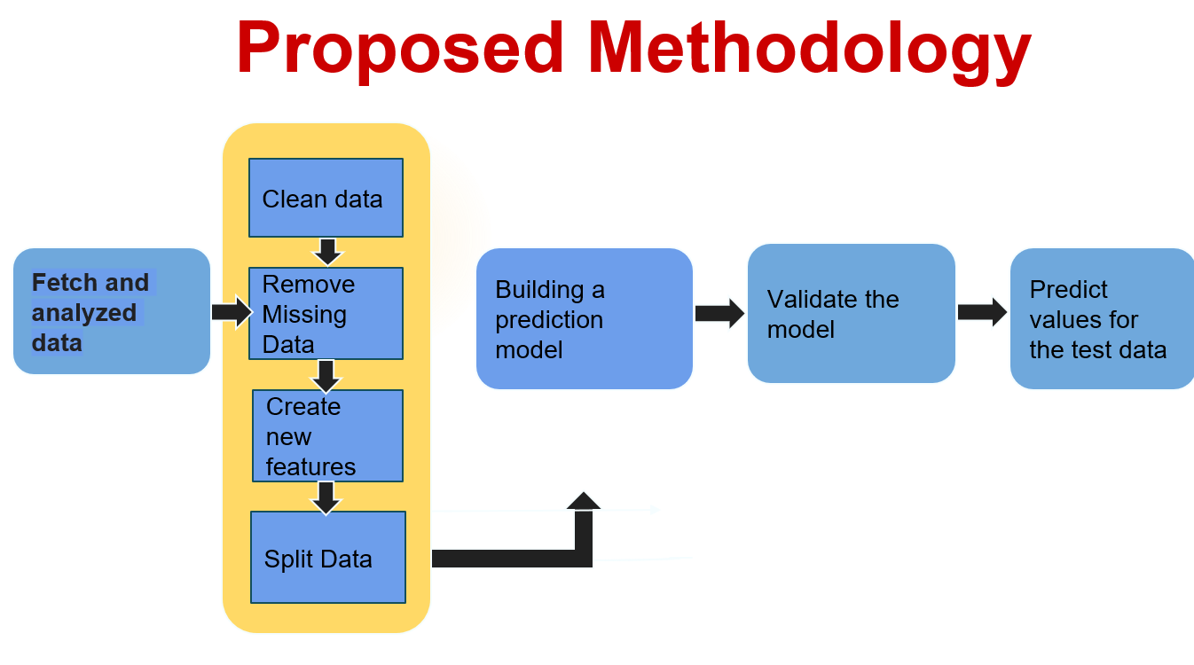

Slide 5
Data Summary:
Battery power - Total energy a battery can store in one time measured in mAh
Blue - Has Bluetooth or not
Clock speed - speed at which microprocessor executes instructions
Dual_sim - Has dual sim support or not
Fc - Front Camera megapixels
Four_g - Has 4G or not
Int_memory - Internal Memory in Gigabytes
M_dep - Mobile Depth in cm

Slide 6

Mobile_wt - Weight of mobile phone
N_cores - Number of cores of processor
P c - Primary Camera megapixels
Px_height - Pixel Resolution Height
Px_width - Pixel Resolution Width
Ram - Random Access Memory in MegaBytes
Sc_h - Screen Height of mobile in cm
Sc_w - Screen Width of mobile in cm
Talk_time - longest that a single battery charge
can last over a call
three_g – Has 3G or not
Touch_screen -Has touch screen or not
Wi-Fi-Has WIFI or not

Slide 7

Dependent variables:
Price_range - This is the target variable with value of
0-low cost,
1-medium cost,
2-High Cost and
3-very high cost.

Slide 8
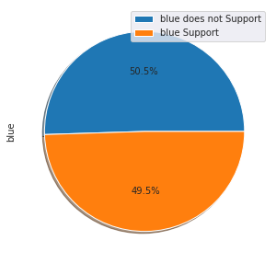
Bluetooth supported or not supported
In this pie chart we can see that half of the mobile has bluetooth supported

Slide 9
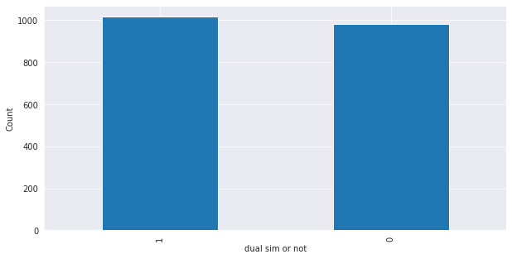
Dual sim or not
Here we can see that the dual sim supported and not supported both has almost similar number of mobile phone

Slide 10
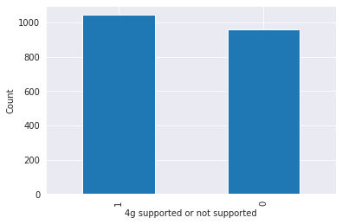
4g supported or not supported
Here we can see that the 4g supported and not supported both has little variation

Slide 11
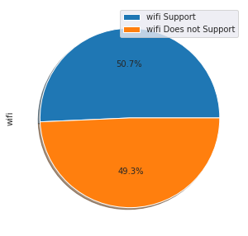
In this pie chart we can see that almost half of the mobile has wifi supported

Slide 12
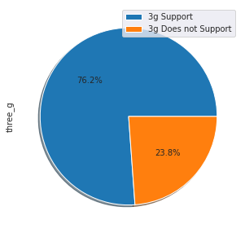
In this pie chart we can see that 76% mobile phone has 3g supported

Slide 13
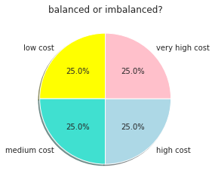
Here we have seen that whether the data is balanced or not

Slide 14
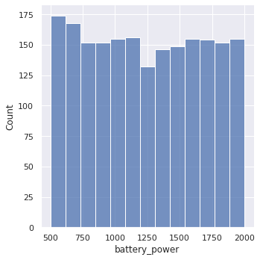
mAh of Battery power
this plot shows how the battery mAh is spread. there is a gradual increase as the price range increases

Slide 15
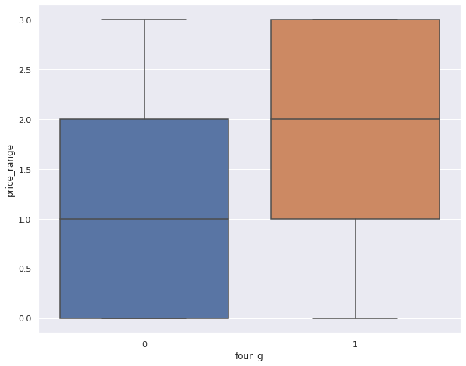
Relation Between Price Range & four_g
The box plot shows that the price is high if the phone is 4g supported

Slide 16
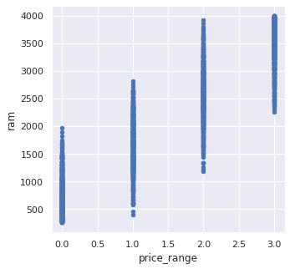
Relation Between Price Range & ram
Ram has continuous increase with price range while moving from Low cost to Very high cost

Slide 17
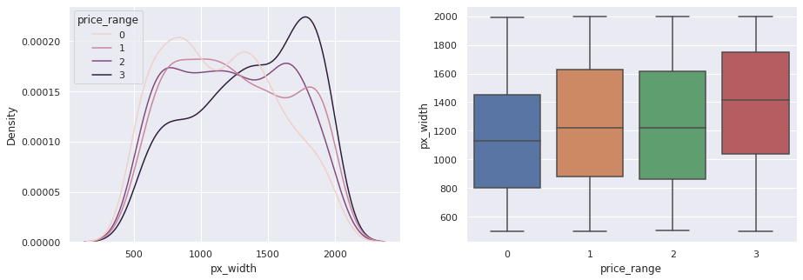
Relation Between Price Range & px_width
There is not a continuous increase in pixel width as we move from Low cost to Very high cost. Mobiles with 'Medium cost' and 'High cost' has almost equal pixel width. so we can say that it would be a driving factor in deciding price_range.

Slide 18
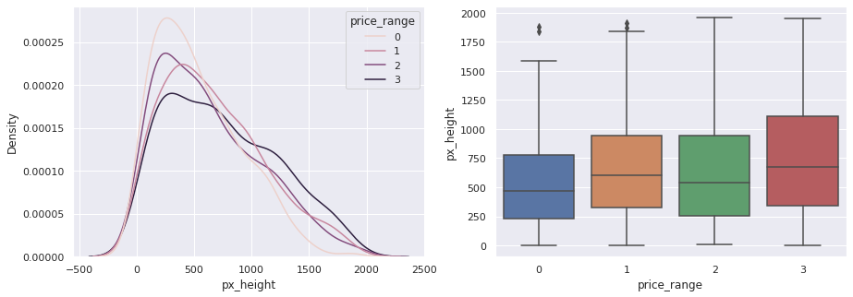
Relation Between Price Range & px_height
Pixel height is almost similar as we move from Low cost to Very high cost. Little variation in pixel_height.

Slide 19
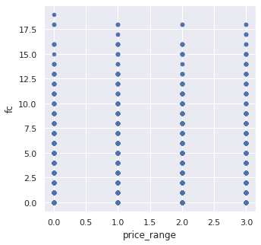
This features distribution is almost similar along all the price ranges variable, it may not be helpful in making predictions

Slide 20
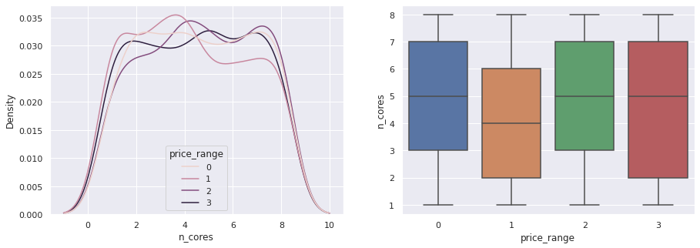
Relationship between the Price Range and n_cores

Slide 21
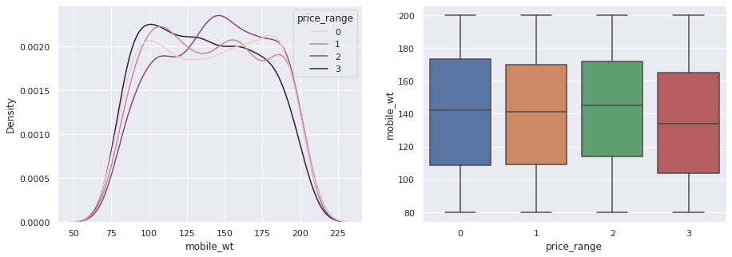
Relationship between the Price Range and mobile weight
As we can see in the above plot costly phone are lighter

Slide 22
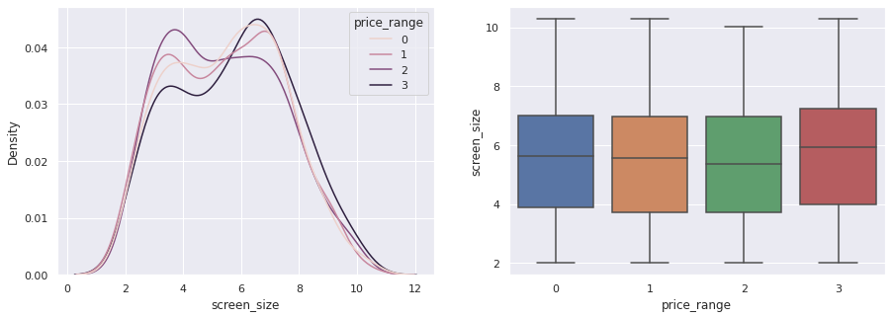
Relationship between the Price Range and screen_size
Screen Size shows little variation along the price range. This can be helpful in predicting the target categories.

Slide 23
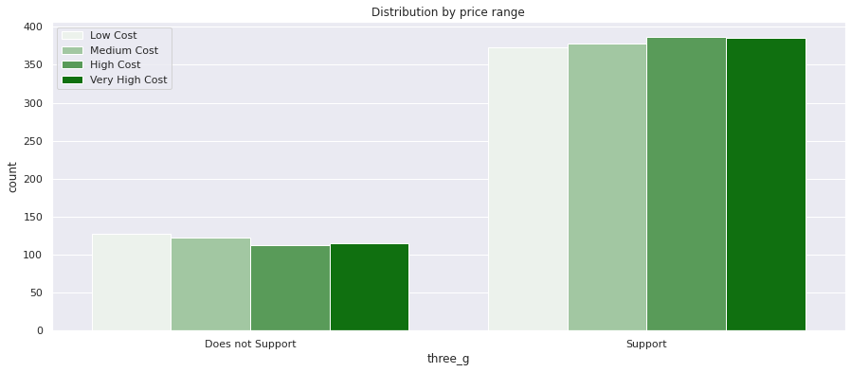
Relationship between the Price Range and three_g
feature 'three_g' play an important feature in prediction

Slide 24
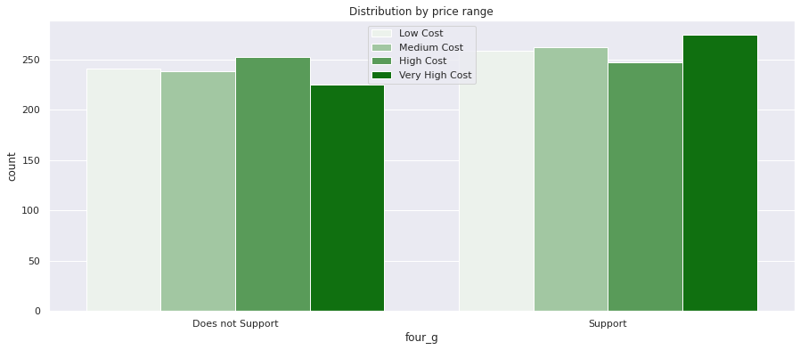
Relationship between the Price Range and four_g
Four_g shows no variation along the price range. This is not helpful in predicting the target categories.

Slide 25
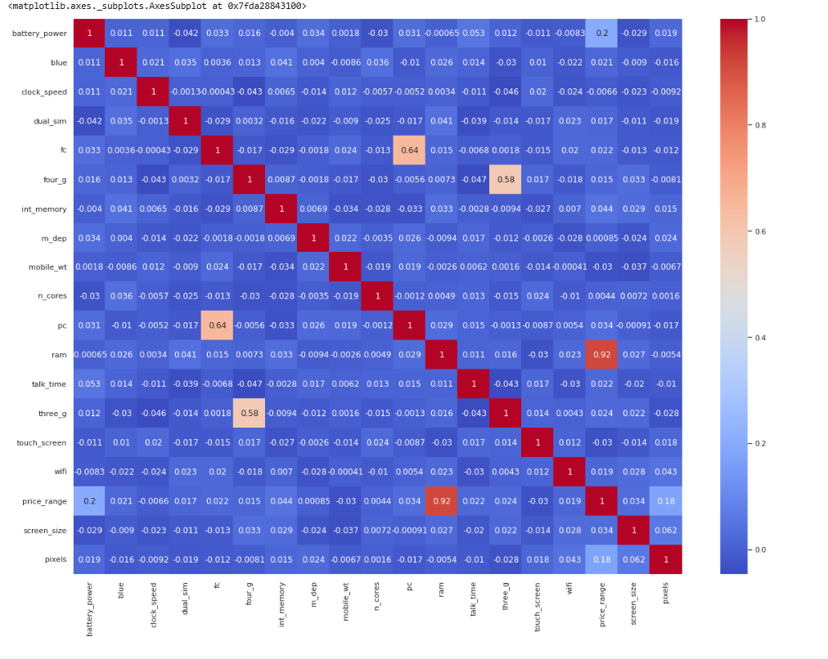

Multivariate analysis
P c is correlated with Fc
px_height and px_width are moderately
correlated
Screen_h and sc_w is moderately correlated.
Ram is highly correlated with price range

Slide 26

Fitting Various Model
Logistic Regression
Random Forest
Random Forest (GINI)
Decision Tree
XGBoost
Naive Bayes
Support Vector Machine
KNN

Slide 27
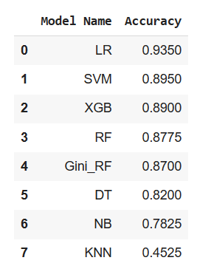
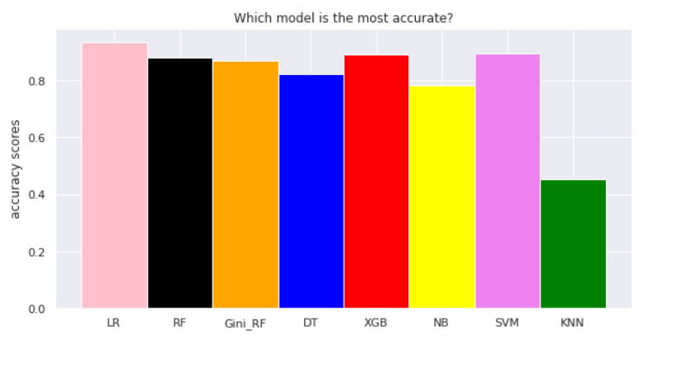
Model Performance Comparison

Slide 28
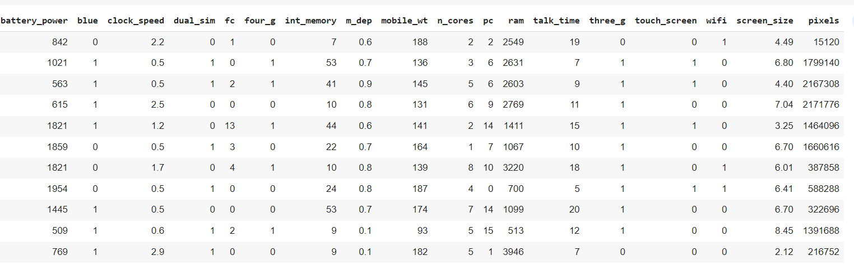
Preparing dataset for modeling
Task : multiclass classification
Train set : (1600 , 18)
Test set : (400, 18)
Response : 0-1-2-3

Slide 29
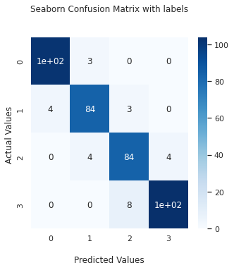
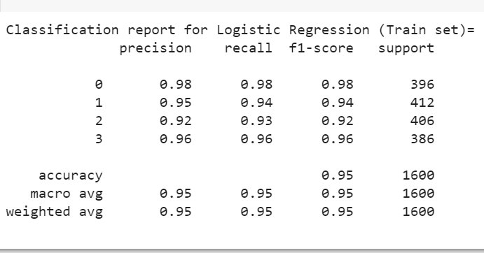
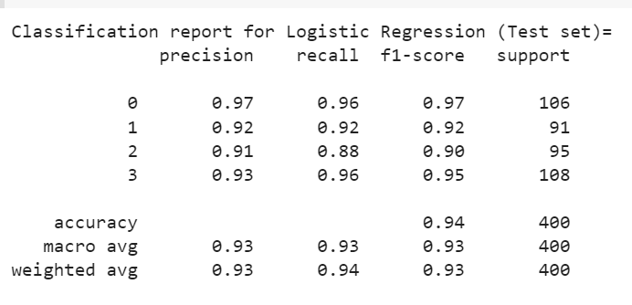
Implementing Logistic Classifier
Train Metrics
Test Metrics

Slide 30
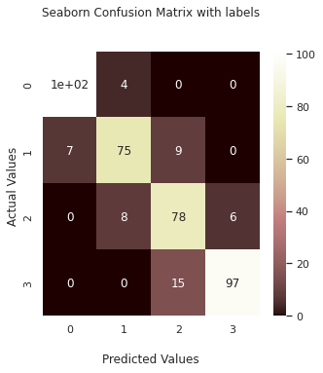
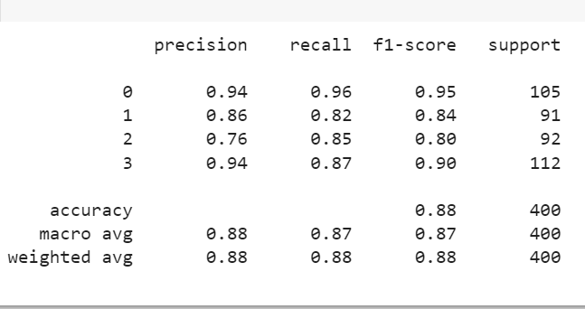
Implementing Random Forest Classifier
Test Metrics

Slide 31
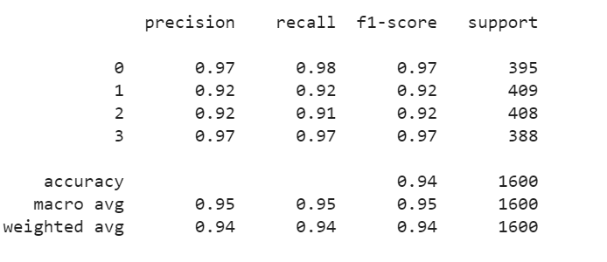

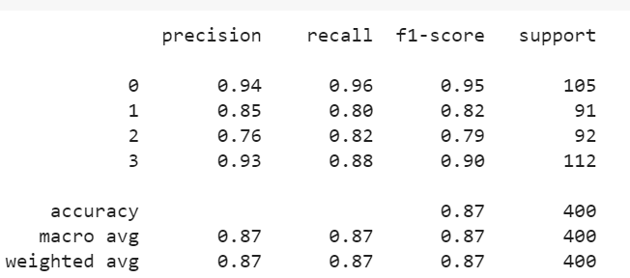
Implementing GINI Random Forest Classifier
Train Metrics
Test Metrics

Slide 32
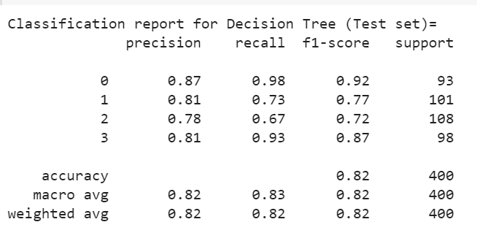
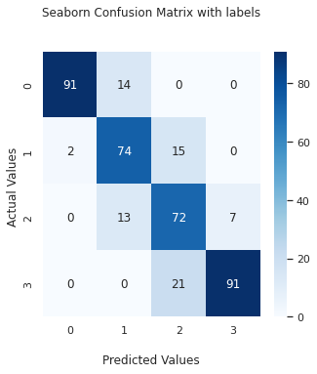
Implementing Decision Tree Classifier
Test Metrics

Slide 33
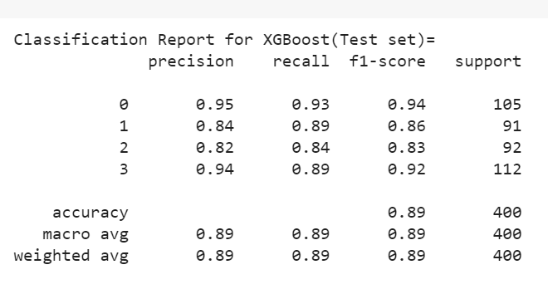
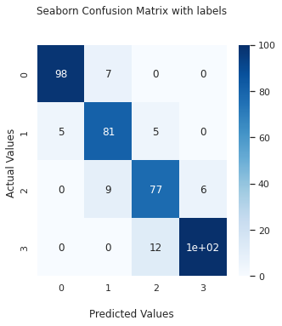
Implementing XGBoost Classifier
Test Metrics

Slide 34
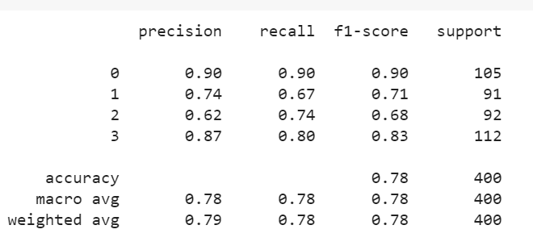
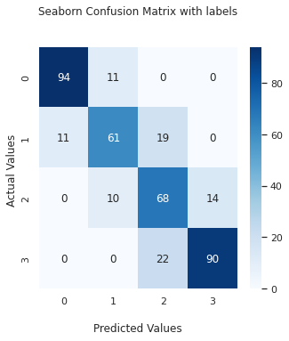
Implementing Naive Bayes Classifier
Test Metrics

Slide 35
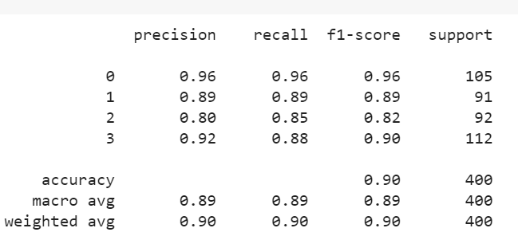
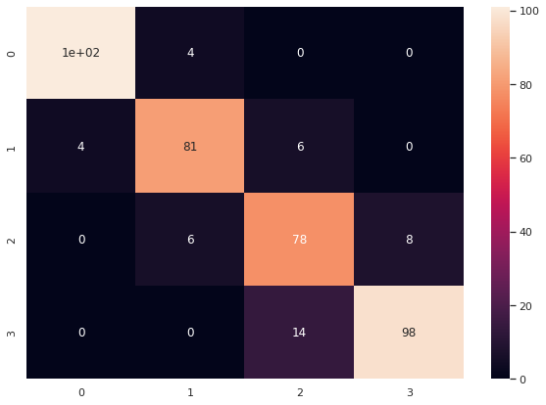
Implementing SVM Classifier
Test Metrics

Slide 36
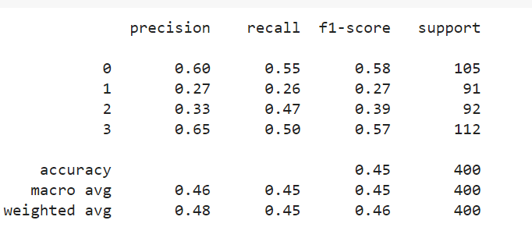
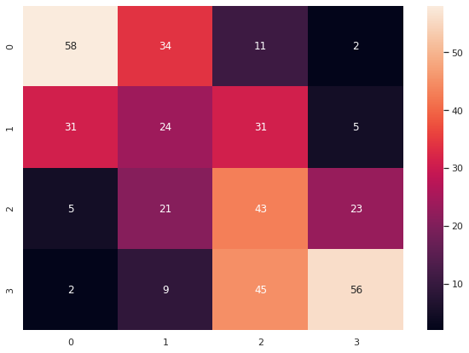
Implementing KNN Classifier
Test Metrics

Slide 37
Model Validation & Selection
Observations:
As seen in the above slides KNN classifier is not giving great result, Naive Bayes and Decision Tree Classifier is bit better than KNN in recall and precision
Logistic Classifier is giving the best results among all of the models
KNN is giving low results among all of them
So we had chosen Logistic classifier for the prediction

Slide 38
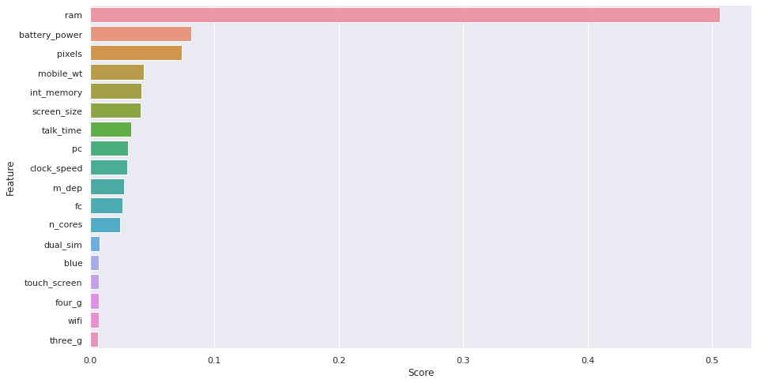
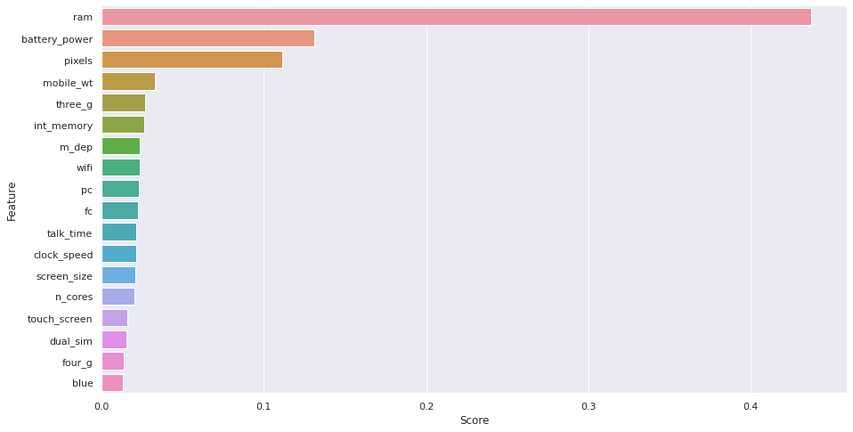
Feature Importance
R a n d o m F o r e s t Classifier
X G B o o s t Classifier

Slide 39
Conclusion :
From EDA we can see that here are mobile phones in 4 price ranges. The
number of elements is almost similar.
Half the devices have Bluetooth, and half don’t
there is a gradual increase in battery as the price range increases
Ram has continuous increase with price range while moving from Low cost to Very high cost
Costly phones are lighter
RAM, battery power, pixels played more significant role in deciding the price range of mobile phone.
From all the above experiments we can conclude that in logistic regression and, Support Vector Machine, we got the best results .
So we can say that in the price range prediction as the ram and battery_power increases the price range will increase for sure.

Slide 40


